Slide 1

Bitcoin and Stock Market
Investigating the Relationship between Bitcoin and Stock Market and Prediction Using AI Algorithm
Presented by :
Group 25
Wei Min Chen 400156352
Yihuan Zhang 400350335
Note: This research is solely for studied purpose, please don’t use it as investing guide.

Slide 2
What is Bitcoin?
Bitcoin is a digital currency which operates free of any central control or the oversight of banks or governments. Instead it relies on peer-to-peer software and cryptography.
Bitcoin was created as a way for people to send money over the internet. The digital currency was intended to provide an alternative payment system that would operate free of central control but otherwise be used just like traditional currencies.

Slide 3
What Is the Stock Market?
The stock market broadly refers to the collection of exchanges and other venues where the buying, selling, and issuance of shares of publicly held companies take place.
The Three major stock indexes in the United States:
Dow Jones Industrial Index
S&P 500 Index
Nasdaq Composite Index

Slide 4
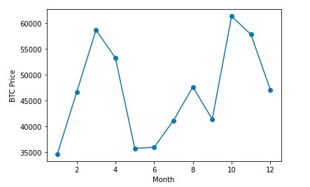
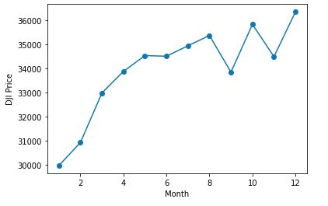
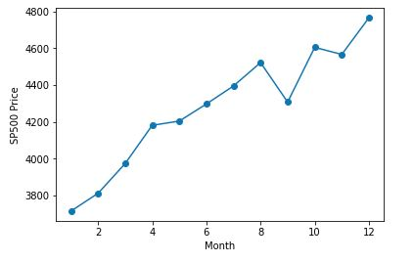
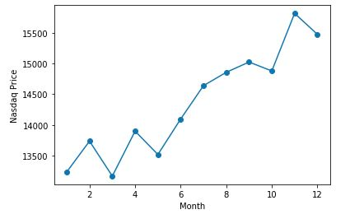
The trends of Bitcoin and Stock indexes in 2021

Slide 5
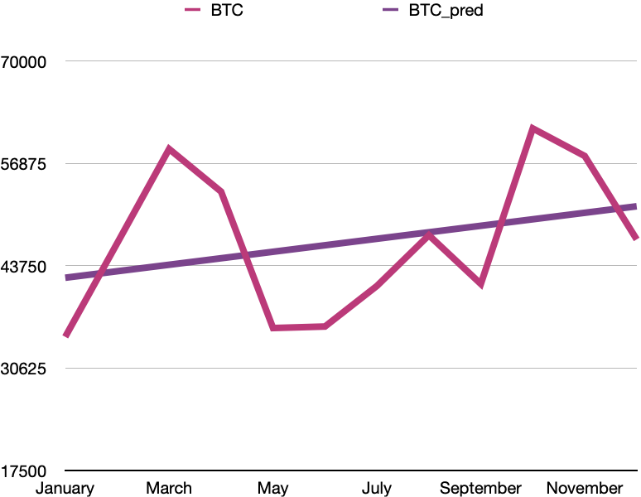
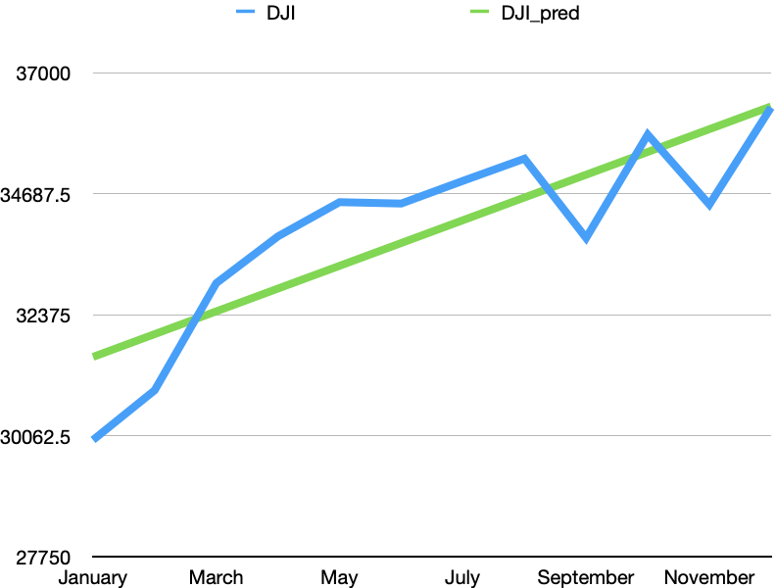
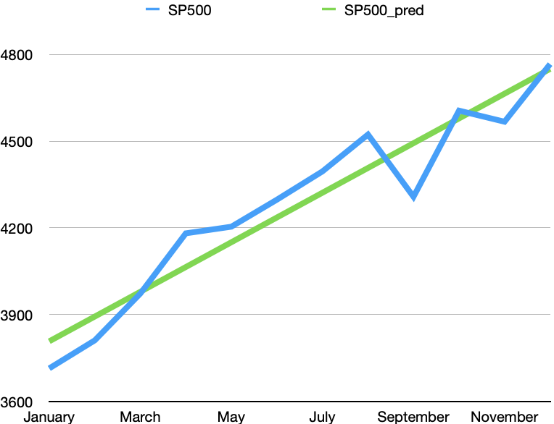
Linear Regression Results
Both BitCoin and US Stock indexes show an increasing trend in the year of 2021, but CryptoCurrency has highest RMSE which indicates that the price distribution is not as tight as the stocks.
(ŷ = 833.86168X + 41373.65742, RMSE = 47641.568)
(ŷ = 833.86168X + 41373.65742, RMSE = 34006.445)
(ŷ = 435.35962X + 31135.58333, RMSE = 4283.199)

Slide 6
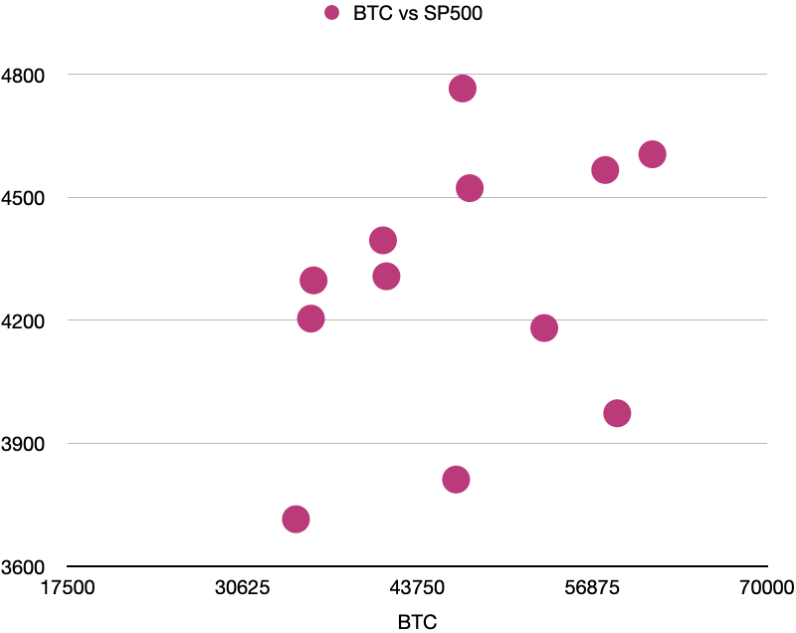
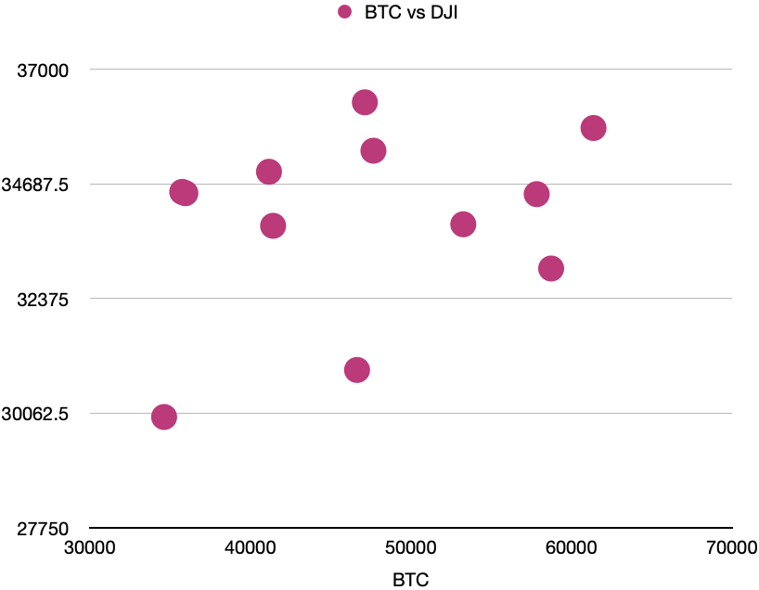
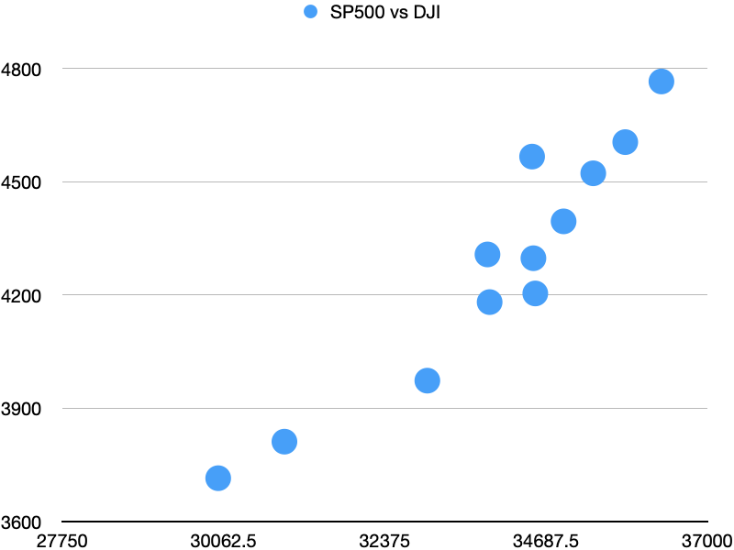
Linear Regression Analysis
CryptoCurrency shows relatively weak relationships with stocks, but stock indexes show a strong relationship between each other.
(BitCoin price and S&P 500, weak relationship)
(BitCoin price and Dow Jones, weak relationship)
(S&P 500 price and Dow Jones, strong relationship)

Slide 7
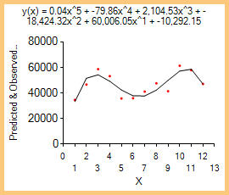
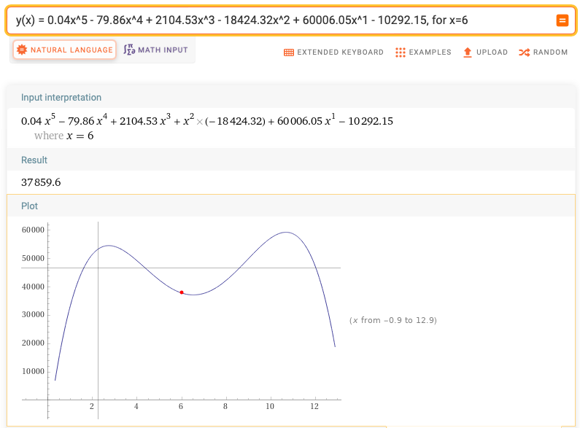
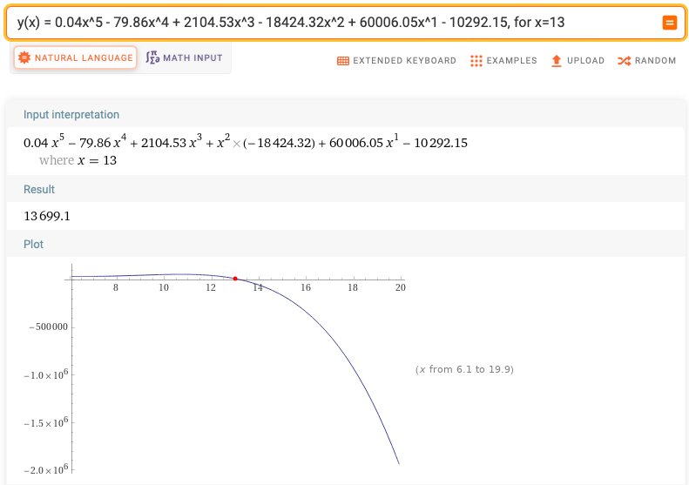
Can we predict the future price of Bitcoin by AI Algorithm?
We have tried Linear regression, polynomial regression and Genetic Algorithm. However, none of them can predict the future price of Bitcoin very well.
(A degree of 5 Polynomial function that describes the BitCoin in 2021)
(The plot of the function with month X in between 1 and 12)
(The plot of the function with month X at 13)

Slide 8
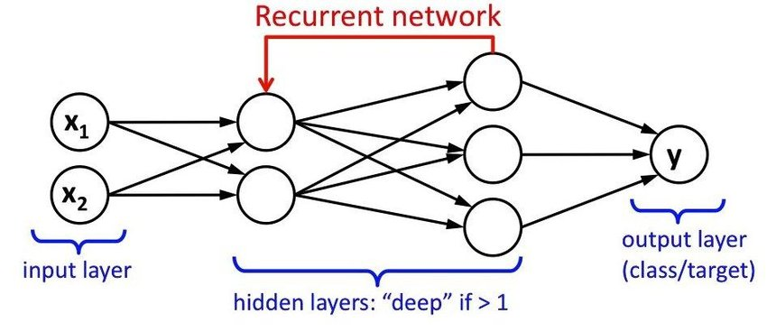
Introduce the LSTMs Algorithm
Long Short-Term Memory, LSTM is a special kind of RNN(Recurrent Neural Network)
Designed to overcome limitation of RNNs such as Gradient Vanishing and exploding
Complex Training
Difficulty to process very long sequences
Remembering information for long period of time is intrinsic to LSTM

Slide 9
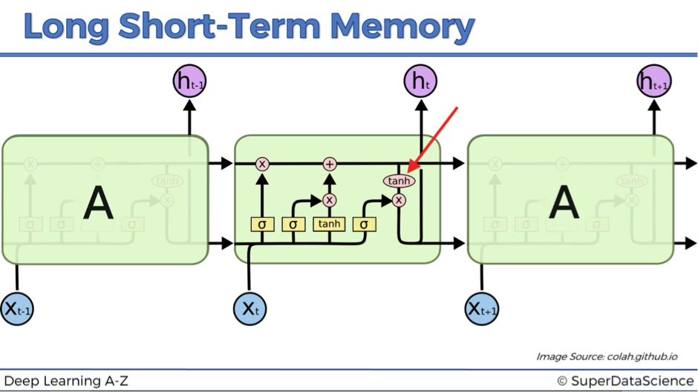
Introduce the LSTMs Algorithm

Slide 10
Let’s load some data!!!

Slide 11
Thank you for your time!

Slide 12
References
Biswal, A. (2022, Feb 16). An Easy Guide to Stock Price Prediction Using Machine Learning. Retrieved from https://www.simplilearn.com/tutorials/machine-learning-tutorial/stock-price-prediction-using-machine-learning.
Chan, J. (2022, March 12). What Is the Stock Market? Retrieved from https://www.investopedia.com/terms/s/stockmarket.asp.
Sparkes, M. (n.d.). What is bitcoin and how does it work? Retrieved from https://www.newscientist.com/definition/bitcoin/.
Bitcoin (BTC) price per day from October 2013 to April 1, 2022: https://www-statista-com.libaccess.lib.mcmaster.ca/statistics/326707/bitcoin-price-index/
Monthly development of the Dow Jones Industrial Average index from November 2013 to January 2022: https://www-statista-com.libaccess.lib.mcmaster.ca/statistics/261690/monthly-performance-of-djia-index/
Monthly development of the S&P 500 index from October 2017 to January 2022: https://www-statista-com.libaccess.lib.mcmaster.ca/statistics/697624/monthly-sandp-500-index-performance/

